Slide 1


Slide 2


OUTSOURCED MINDS
AI’S HIDDEN COST TO OUR KIDS

Slide 3

PICTURE THIS

Slide 4




A DAY IN THE LIFE OF A COLLEGE STUDENT

Slide 5

THE SHORTCUT SOCIETY

Slide 6

CHEATING
IS NOW UNIVERSAL

Slide 7


WHAT ELSE DOES TECH DO FOR SKYLAR?

Slide 8

PLAYING LIFE IN CHEAT MODE

Slide 9
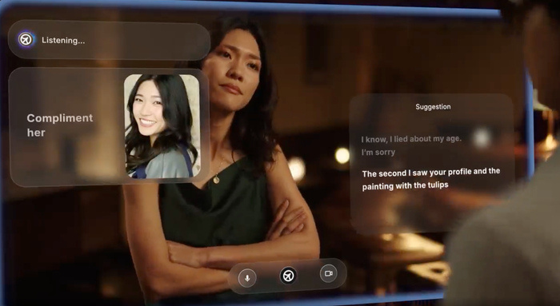
NOW LET’S TALK ABOUT DATING

Slide 10

WHERE DOES IT
GO FROM HERE?

Slide 11
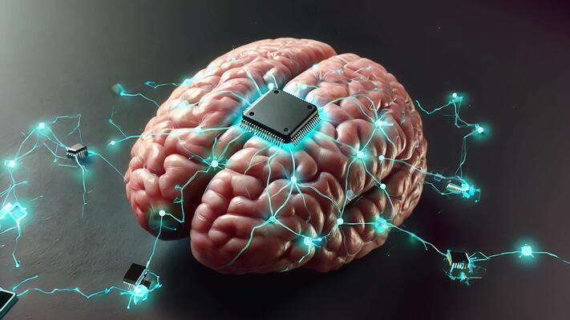
WHAT DOES LIFE LOOK LIKE 30 YEARS FROM NOW?

Slide 12
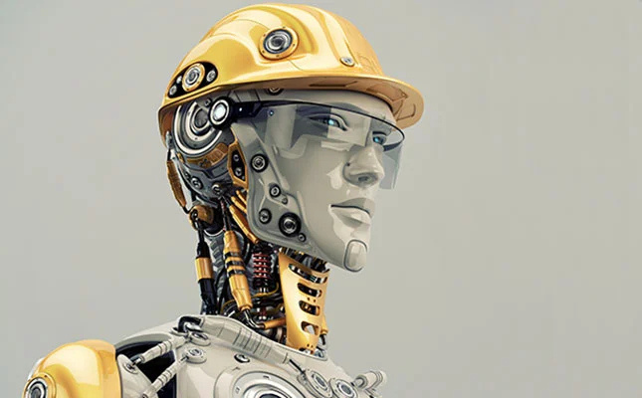
THE IRONY OF IT ALL

Slide 13
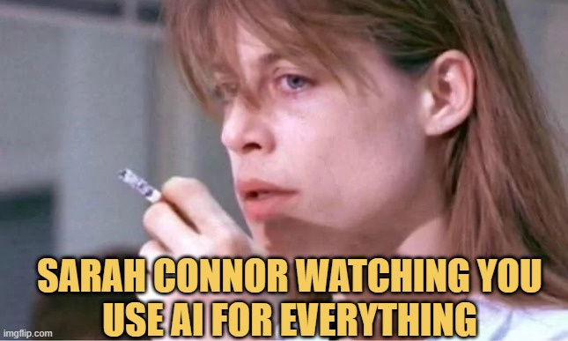
THE WAY FORWARD

Slide 14

WHY ARE WE REALLY HERE AT THIS MOMENT ?

Slide 15




LEARN MORE AT:
THE AI PHILOSOPHER

Slide 16

THANK YOU!
MICHAEL ASHLEY
HTTPS://SUBSTACK.COM/@MICHAELTHEAIPHILOSOPHER

